Slide 1
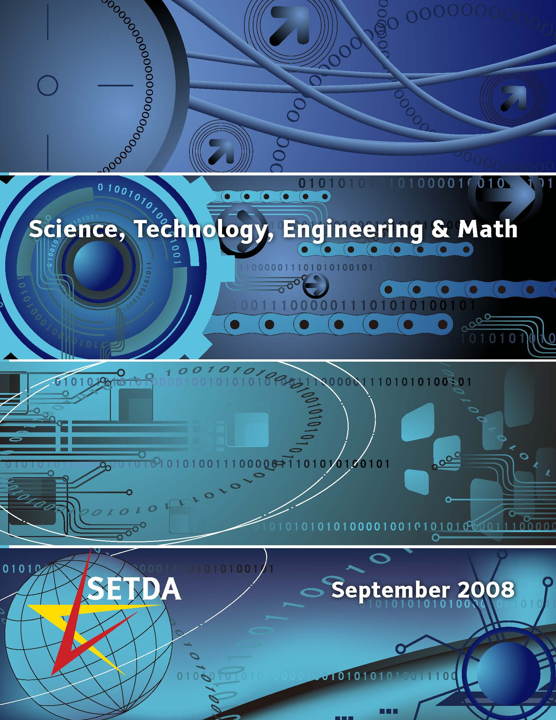

Slide 2
Key Issues
The U.S. needs 400,000 new graduates in STEM fields by 2015.
Jobs in traditionally American-led industries outside of science & technology such as farming, health care, and finance require a strong knowledge of STEM.
We need to cultivate the next generation of innovators and big thinkers

Slide 3
Current State of STEM Education
Many students are not receiving an education geared towards STEM
Focus is on specialty or magnet high schools (over 100 nationwide)
In most schools, STEM subject areas are not taught on an everyday basis.
  29% of K-5 teachers report teaching science two or fewer days per week

Slide 4
Barriers to STEM Education
Societal belief that science, technology, engineering, and math are not for everyone.
Kids don’t see relevance of STEM education.
Lack of qualified teachers.
Inadequate pre-service training in STEM content areas for teachers.
Inadequate policies to recruit and retain teachers.

Slide 5
Key Recommendations
Obtain Societal Support for STEM Education
Expose Students to STEM Careers
Provide On-Going and Sustainable STEM Professional Development
Provide STEM Pre-Service Teacher Training
Recruit and Retain STEM Teachers

